Slide 1

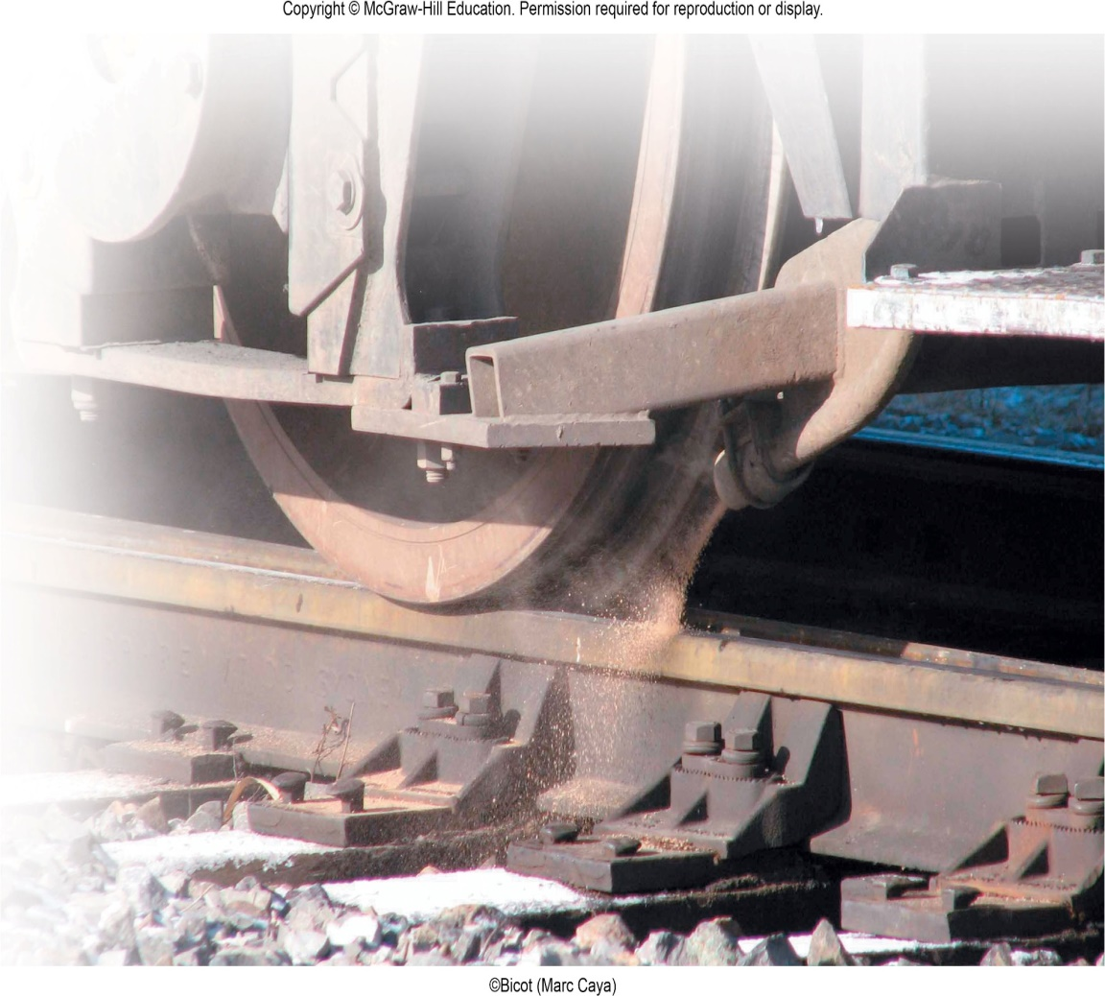
VECTOR MECHANICS FOR ENGINEERS
By: Fardinand P. Beer; E. Russell Johnston, Jr.; David F. Mazurek
ENGINEERING 3120
STATICS
CHAPTER 8
FRICTION
Slides revised by:
A.A. KHANDKER, Ph.D., P.E
Copyright: McGraw Hill Education

Slide 2
FRICTION - TOPICS IN CHAPTER 8
Introduction
Laws of Dry Friction. Coefficients of Friction.
Angles of Friction
Problems Involving Dry Friction
Sample Problem 8.1
Sample Problem 8.3
Wedges
Square-Threaded Screws
Sample Problem 8.5
Journal Bearings. Axle Friction.
Thrust Bearings. Disk Friction.
Wheel Friction. Rolling Resistance.
Sample Problem 8.6
Belt Friction.
Sample Problem 8.8

Slide 3
FRICTION - INTRODUCTION
In preceding chapters, it was assumed that surfaces in contact were either frictionless (surfaces could move freely with respect to each other) or rough (tangential forces prevent relative motion between surfaces).
Actually, no perfectly frictionless surface exists. For two surfaces in contact, tangential forces, called friction forces, will develop if one attempts to move one relative to the other.
However, the friction forces are limited in magnitude and will not prevent motion if sufficiently large forces are applied.
The distinction between frictionless and rough is, therefore, a matter of degree.
There are two types of friction:
a) dry or Coulomb friction: between non-lubricated surfaces
b) fluid friction: applies to lubricated mechanisms.
The present discussion is limited to dry friction between non-lubricated surfaces.

Slide 4
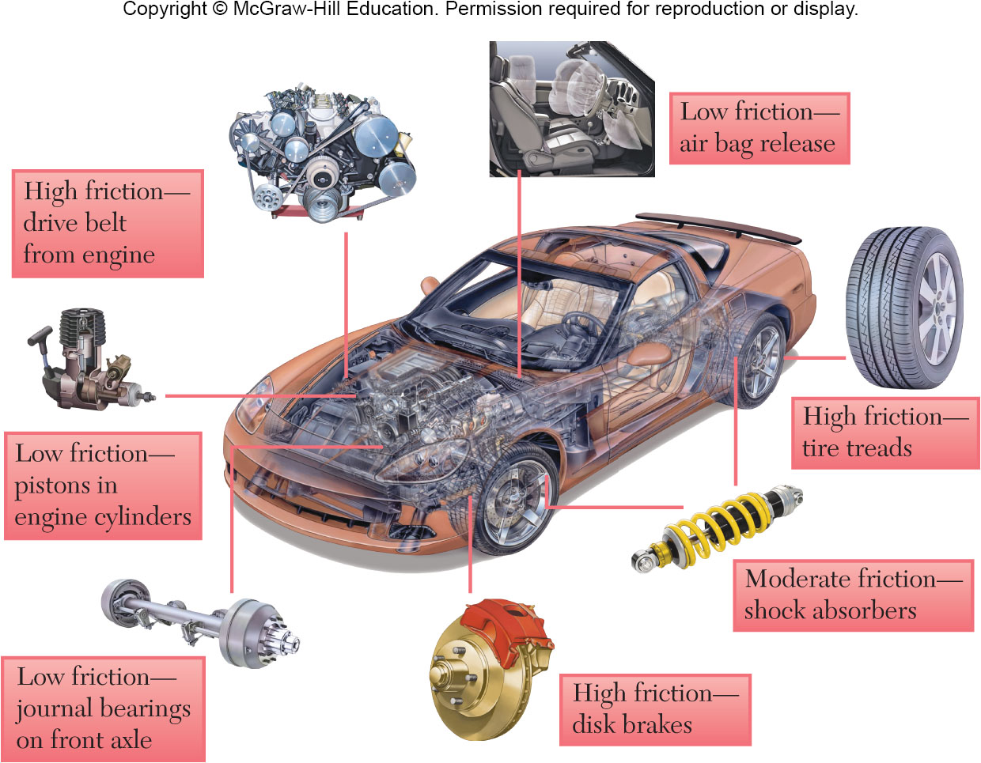
FRICTION - APPLICATION
Friction is both problematic and useful in many engineering applications.

Slide 5
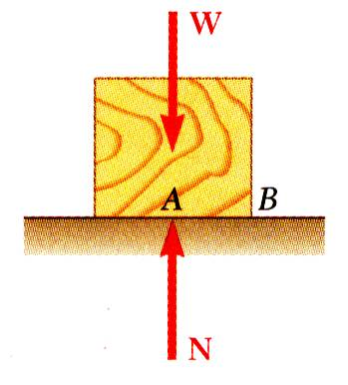
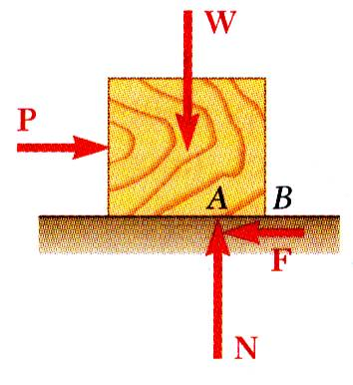
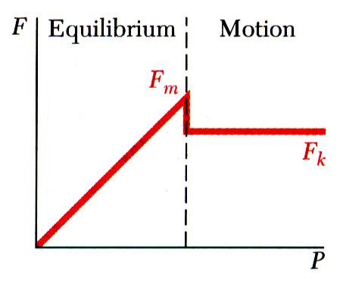
THE LAWS OF DRY FRICTION
Small horizontal force P applied to block. For block to remain stationary, in equilibrium, a horizontal component F of the surface reaction is required.
Block of weight W placed on horizontal surface. Forces acting on block are its weight and reaction of surface N.
F is a static-friction force.
As P increases, the static-friction force F increases as well until it reaches a maximum value F_{m}.
Further increase in P causes the block to begin to move as F drops to a smaller kinetic-friction force F_{k}.

Slide 6
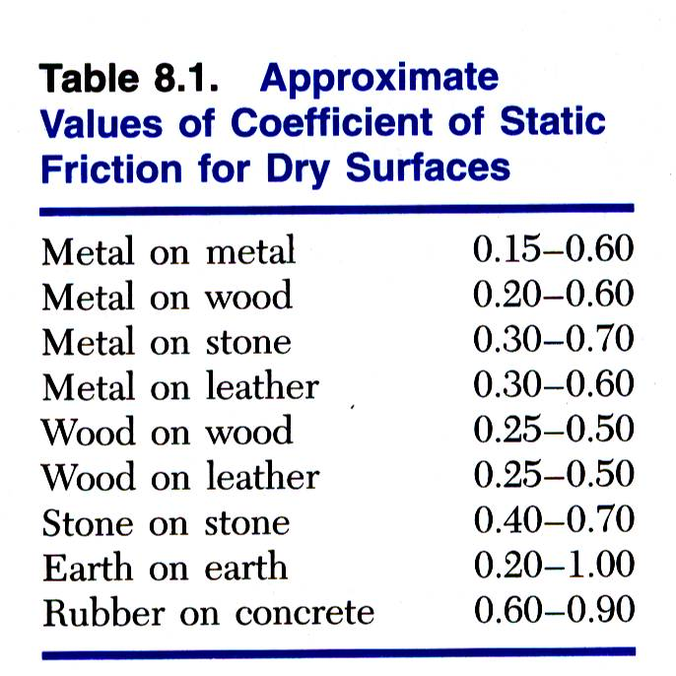
THE LAWS OF DRY FRICTION – COEFFICIENT OF FRICTION
Maximum static-friction force:
Kinetic-friction force:
Maximum static-friction force and kinetic-friction force are:
proportional to normal force
dependent on type and condition of contact surfaces
independent of contact area
μ_{s} is the coefficient of static-friction
μ_{k} is the coefficient of kinetic-friction

Slide 7
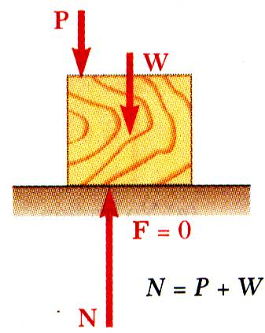
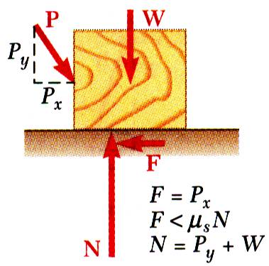
THE LAWS OF DRY FRICTION – COEFFICIENT OF FRICTION
Four situations can occur when a rigid body is in contact with a horizontal surface:
STATIC FRICTION
Situation 1
Situation 2
No friction, (P_{x} = 0)
No motion, (P_{x} = 0)
Small friction, (P_{x} > 0)
No motion, (P_{x} < F_{m})

Slide 8
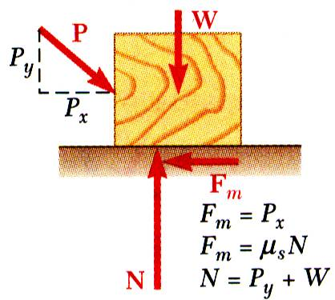
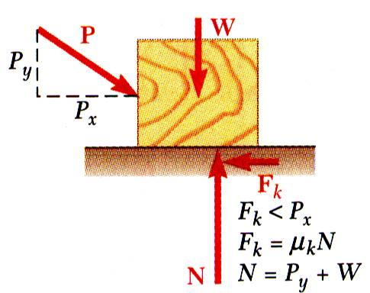
THE LAWS OF DRY FRICTION – COEFFICIENT OF FRICTION
Four situations can occur when a rigid body is in contact with a horizontal surface:
STATIC FRICTION
KINETIC FRICTION
Situation 3
Situation 4
Motion impending, (P_{x} = F_{m})
Motion, (P_{x} > F_{m})

Slide 9
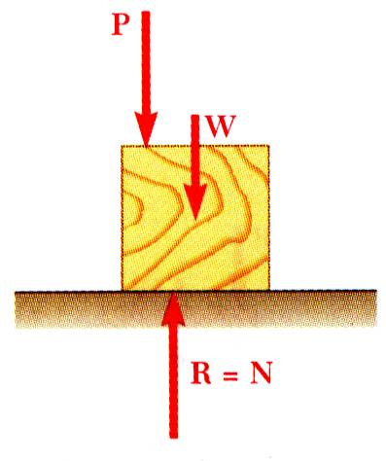
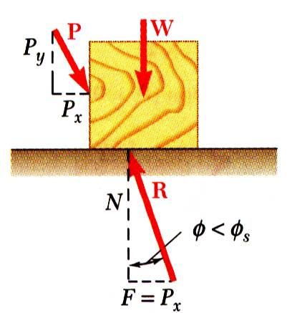
THE LAWS OF DRY FRICTION – ANGLE OF FRICTION
It is sometimes convenient to replace normal force N and friction force F by their resultant R:
STATIC FRICTION
No motion
No friction

Slide 10
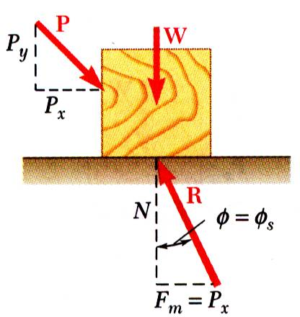
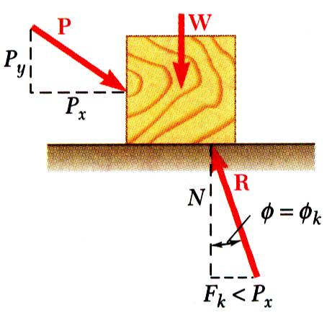
THE LAWS OF DRY FRICTION – ANGLE OF FRICTION
It is sometimes convenient to replace normal force N and friction force F by their resultant R:
STATIC FRICTION
STATIC FRICTION
KINETIC FRICTION
No friction
No motion
Motion impending
Motion

Slide 11
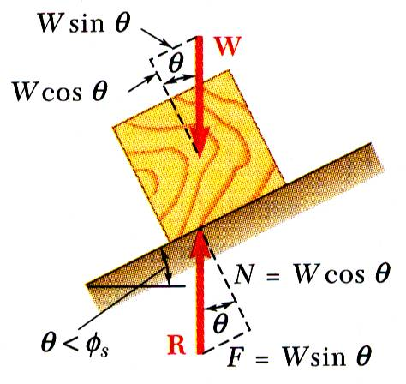
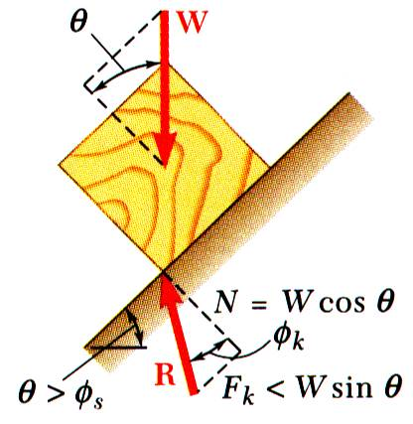
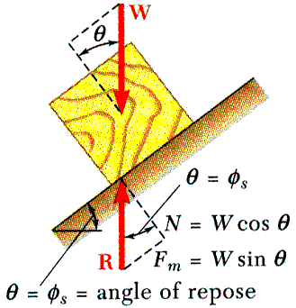
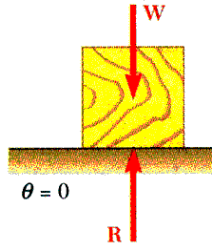
INCLINED SURFACE – ANGLES OF FRICTION
Consider block of weight W resting on board with variable inclination angle θ.
STATIC FRICTION
STATIC FRICTION
KINETIC FRICTION
No friction
No motion
No motion
Motion impending
Motion

Slide 12
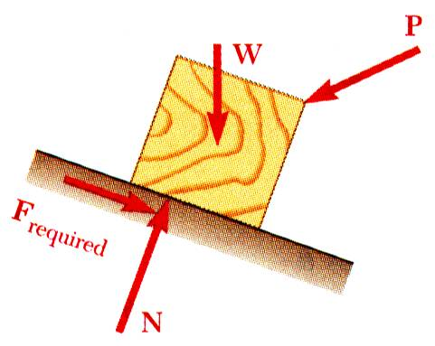
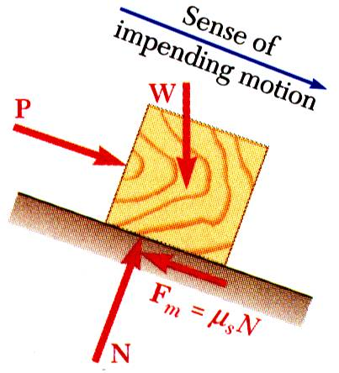
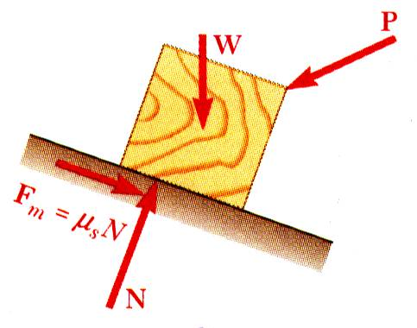
PROBLEMS INVOLVING DRY FRICTION
All applied forces known
Coefficient of static friction is known
Determine whether body will remain at rest or slide
All applied forces known
Motion is impending
Determine value of coefficient of static friction.
Coefficient of static friction is known
Motion is impending
Determine magnitude or direction of one of the applied forces

Slide 13
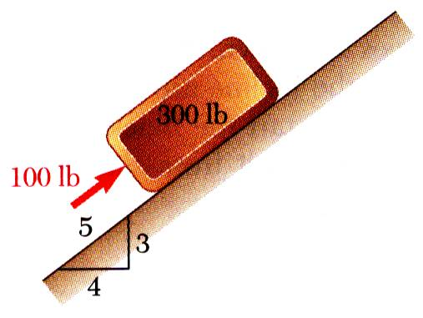
EXAMPLE PROBLEM 8.1
SOLUTION STEPS:
Determine values of friction force and normal reaction force from plane required to maintain equilibrium
Calculate maximum friction force and compare with friction force required for equilibrium. If it is greater, block will not slide.
If maximum friction force is less than friction force required for equilibrium, block will slide. Calculate kinetic-friction force.
A 100 lb force acts as shown on a 300 lb block placed on an inclined plane. The coefficients of friction between the block and plane are μ_{s} = 0.25 and μ_{k} = 0.20. Determine whether the block is in equilibrium and find the value of the friction force.

Slide 14
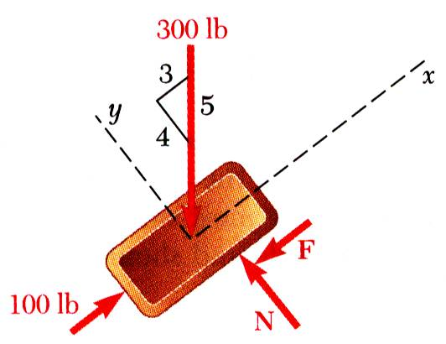
EXAMPLE PROBLEM 8.1 - SOLUTION
Determine values of friction force and normal reaction force from plane required to maintain equilibrium.
Calculate maximum friction force and compare with friction force required for equilibrium. If it is greater, block will not slide.
The block will slide down the plane.

Slide 15
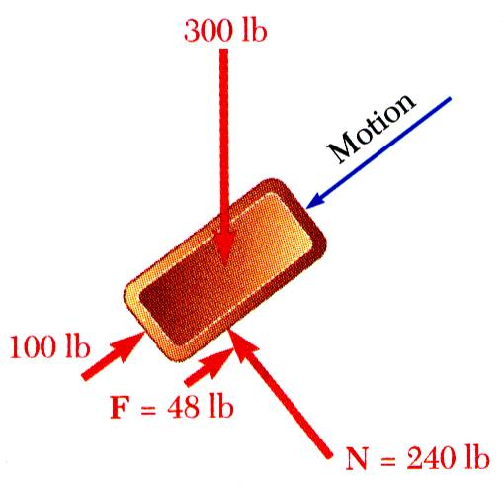
EXAMPLE PROBLEM 8.1 – SOLUTION (continued)
If maximum friction force is less than friction force required for equilibrium, block will slide. Calculate kinetic-friction force.

Slide 16
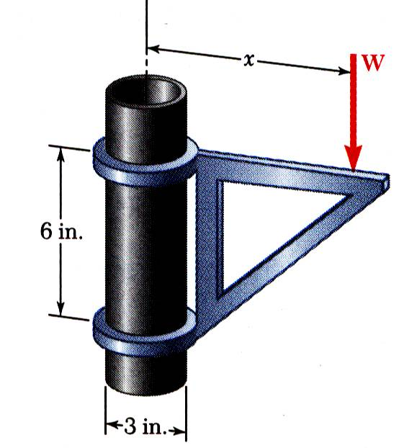
EXAMPLE PROBLEM 8.3
The moveable bracket shown may be placed at any height on the 3-in. diameter pipe. If the coefficient of friction between the pipe and bracket is 0.25, determine the minimum distance x at which the load can be supported. Neglect the weight of the bracket.
SOLUTION STEPS:
When W is placed at minimum x, the bracket is about to slip and friction forces in upper and lower collars are at maximum value.
Apply conditions for static equilibrium to find minimum x.

Slide 17
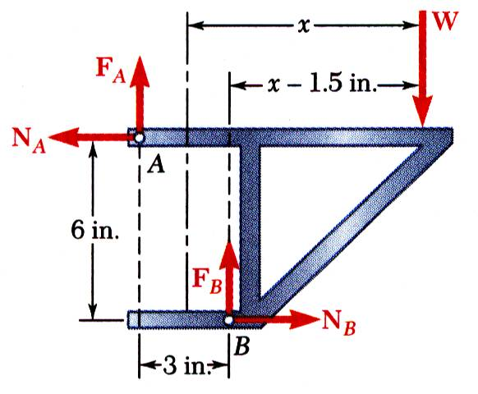
EXAMPLE PROBLEM 8.3 - SOLUTION
When W is placed at minimum x, the bracket is about to slip and friction forces in upper and lower collars are at maximum value.
Apply conditions for static equilibrium to find minimum x.

Slide 18
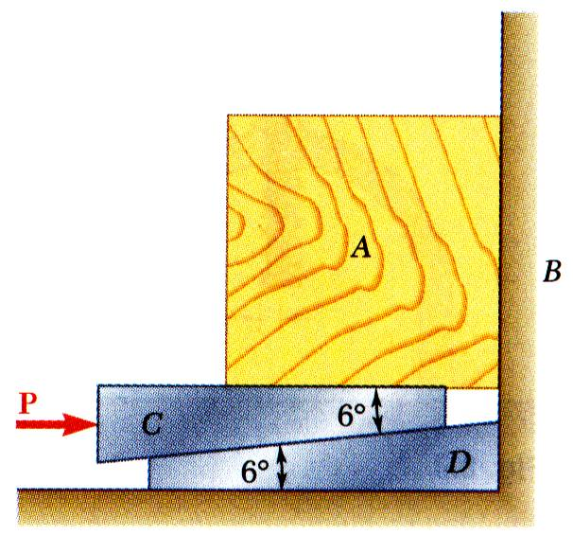
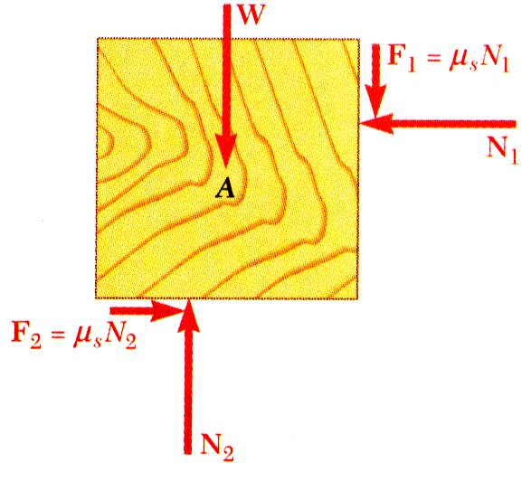
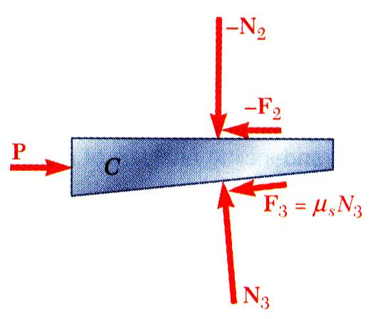
WEDGES
Wedges - simple machines used to raise heavy loads.
Force required to lift block is significantly less than block weight.
Friction prevents wedge from sliding out.
Want to find minimum force P to raise block.
Block as free-body
Wedge as free-body
or
or

Slide 19
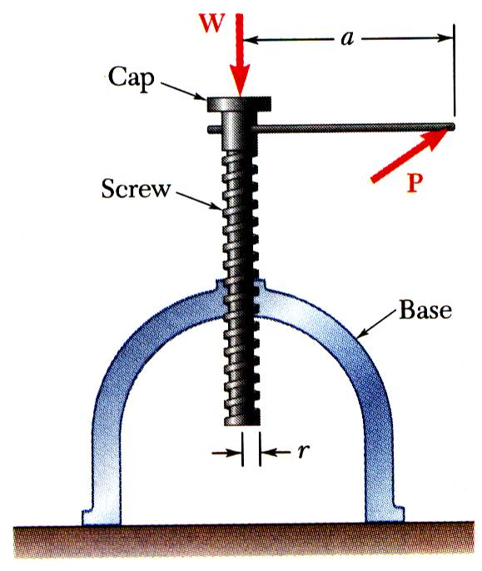
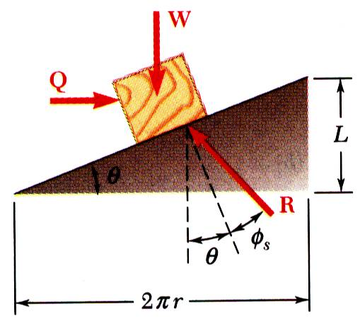
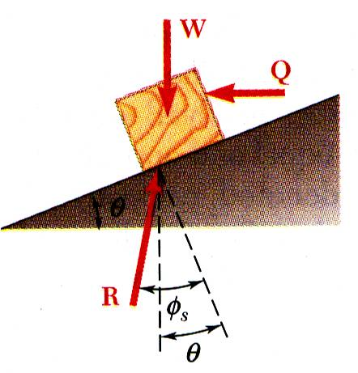
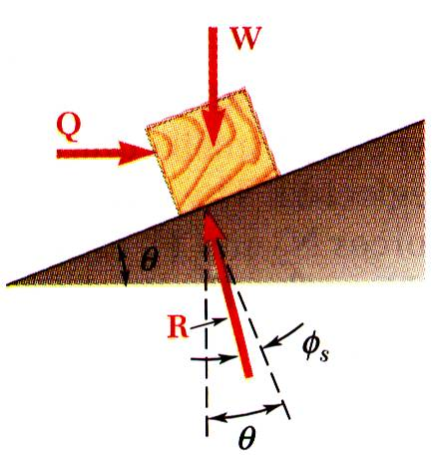
SQUARE-THREADED SCREWS
Square-threaded screws frequently used in jacks, presses, etc. Analysis similar to block on inclined plane. Recall friction force does not depend on area of contact.
Thread of base has been “unwrapped” and shown as straight line. Slope is 2πr horizontally and lead L vertically.
Moment of force Q is equal to moment of force P.
Impending motion upwards. Solve for Q.
Self-locking, solve for Q to lower load.
Non-locking, solve for Q to hold load.

Slide 20
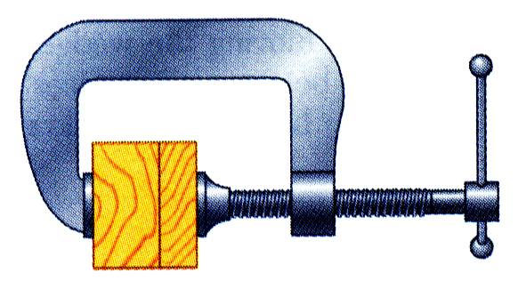
SAMPLE PROBLEM 8.5
SOLUTION STEPS:
Calculate lead angle and pitch angle.
Using block and plane analogy with impending motion up the plane, calculate the clamping force with a force triangle.
With impending motion down the plane, calculate the force and torque required to loosen the clamp.
A clamp is used to hold two pieces of wood together as shown. The clamp has a double square thread of mean diameter equal to 10 mm with a pitch of 2 mm. The coefficient of friction between threads is μ_{s} = 0.30.
If a maximum torque of 40 N*m is applied in tightening the clamp, determine (a) the force exerted on the pieces of wood, and (b) the torque required to loosen the clamp.

Slide 21
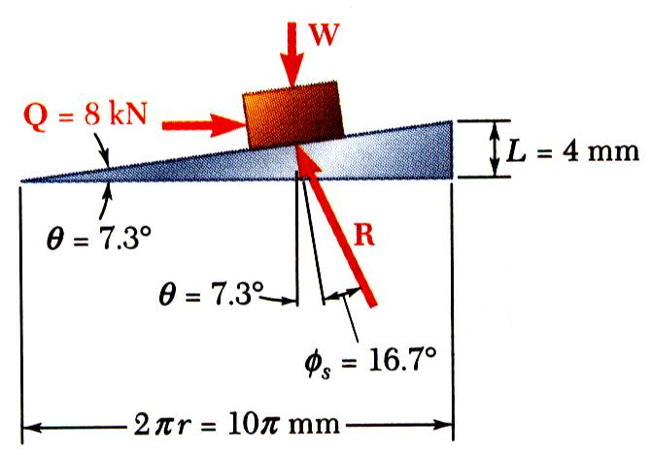
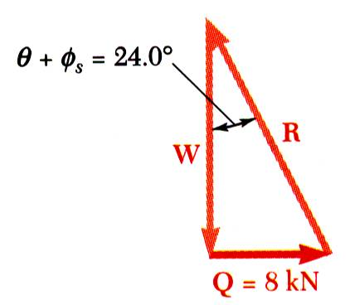
SAMPLE PROBLEM 8.5 - SOLUTION
Calculate lead angle and pitch angle. For the double threaded screw, the lead L is equal to twice the pitch.
Using block and plane analogy with impending motion up the plane, calculate clamping force with force triangle.

Slide 22
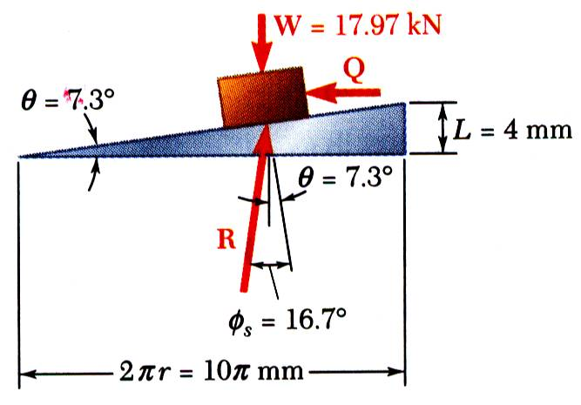
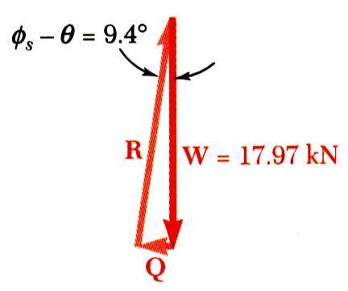
SAMPLE PROBLEM 8.5 – SOLUTION (continued)
With impending motion down the plane, calculate the force and torque required to loosen the clamp.

Slide 23
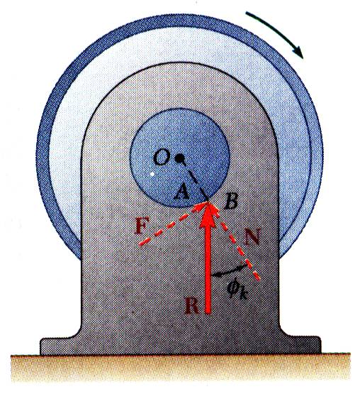
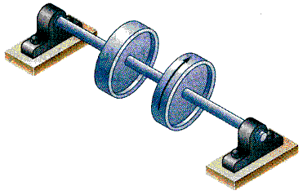
JOURNAL BEARINGS – AXLE FRICTION
Journal bearings provide lateral support to rotating shafts. Thrust bearings provide axial support
Frictional resistance of fully lubricated bearings depends on clearances, speed and lubricant viscosity. Partially lubricated axles and bearings can be assumed to be in direct contact along a straight line.
Forces acting on bearing are weight W of wheels and shaft, couple M to maintain motion, and reaction R of the bearing.
Reaction is vertical and equal in magnitude to W.
Reaction line of action does not pass through shaft center O; R is located to the right of O, resulting in a moment that is balanced by M.
Physically, contact point is displaced as axle “climbs” in bearing.

Slide 24
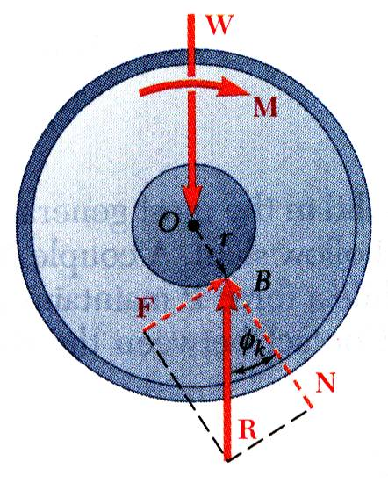
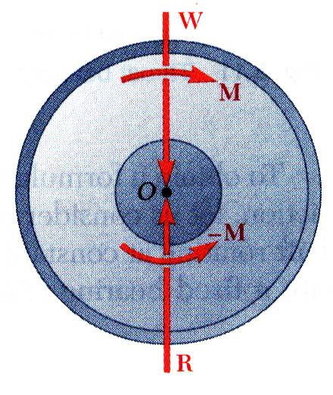
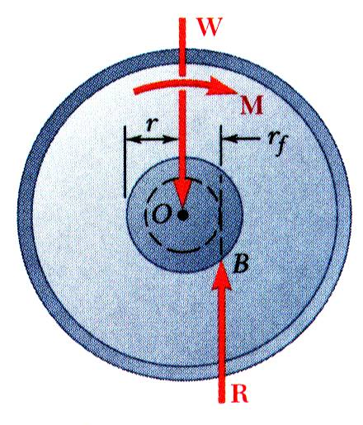
JOURNAL BEARINGS – AXLE FRICTION
Angle between R and normal to bearing surface is the angle of kinetic friction ϕ_{k}.
May treat bearing reaction as force-couple system.
For graphical solution, R must be tangent to circle of friction.

Slide 25
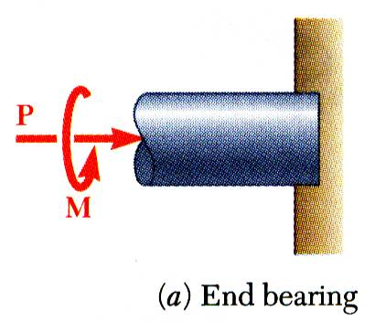
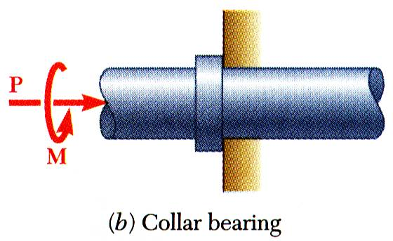
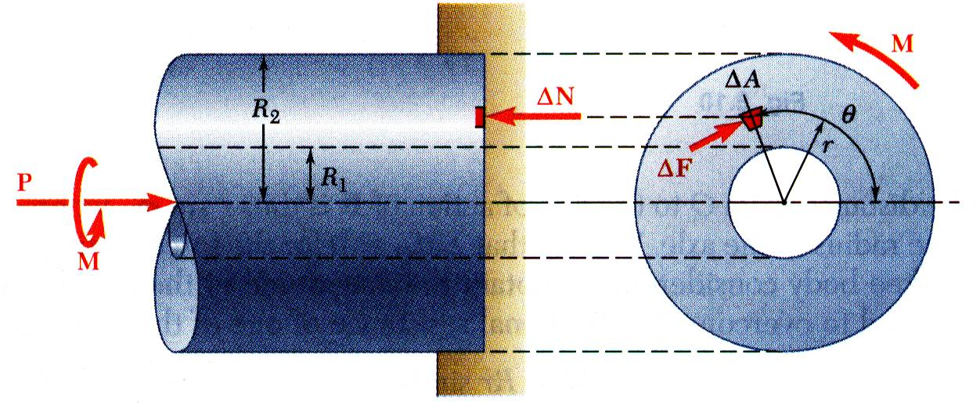
THRUST BEARINGS – DISC FRICTION
Consider rotating hollow shaft:
For full circle of radius R,

Slide 26
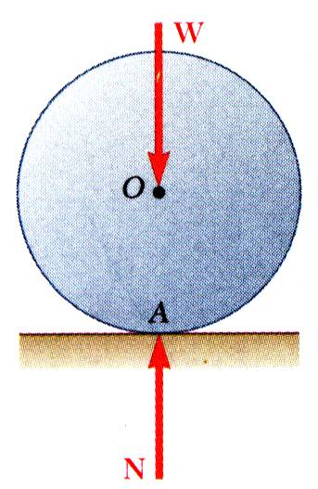
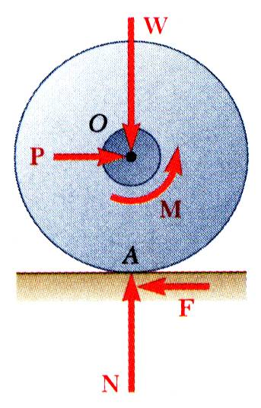
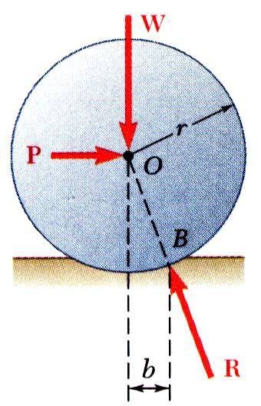
WHEEL FRICTION – ROLLING RESISTANCE
Point of wheel in contact with ground has no relative motion with respect to ground. Ideally, no friction.
Moment M due to frictional resistance of axle bearing requires couple produced by equal and opposite P and F. Without friction at rim, wheel would slide.
Deformations of wheel and ground cause resultant of ground reaction to be applied at B. P is required to balance moment of W about B. Pr = Wb b = coef of rolling resistance

Slide 27
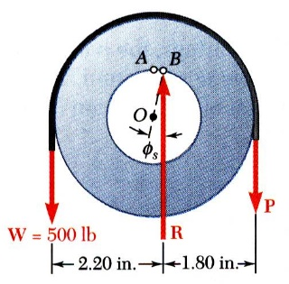


EXAMPLE PROBLEM 8.6
SOLUTION:
A pulley of diameter 4 in. can rotate about a fixed shaft of diameter 2 in. The coefficient of static friction between the pulley and shaft is 0.20.
With the load on the left and force P on the right, impending motion is clockwise to raise load. Sum moments about displaced contact point B to find P.
Determine:
the smallest vertical force P required to start raising a 500 lb load,
the smallest vertical force P required to hold the load, and
the smallest horizontal force P required to start raising the same load.
Impending motion is counter-clockwise as load is held stationary with smallest force P. Sum moments about C to find P.
With the load on the left and force P acting horizontally to the right, impending motion is clockwise to raise load. Utilize a force triangle to find P.

Slide 28

EXAMPLE PROBLEM 8.6 - SOLUTION
SOLUTION:
With the load on the left and force P on the right, impending motion is clockwise to raise load. Sum moments about displaced contact point B to find P.
The perpendicular distance from center O of pulley to line of action of R is
Summing moments about B,

Slide 29

EXAMPLE PROBLEM 8.6 – SOLUTION (continued)
Impending motion is counter-clockwise as load is held stationary with smallest force P. Sum moments about C to find P.
The perpendicular distance from center O of pulley to line of action of R is again 0.20 in. Summing moments about C,

Slide 30

EXAMPLE PROBLEM 8.6 – SOLUTION (continued)
With the load on the left and force P acting horizontally to the right, impending motion is clockwise to raise load. Utilize a force triangle to find P.
Since W, P, and R are not parallel, they must be concurrent. Line of action of R must pass through intersection of W and P and be tangent to circle of friction which has radius r_{f} = 0.20 in.
From the force triangle,

Slide 31


BELT FRICTION
Relate T₁ and T₂ when belt is about to slide to right.
Draw free-body diagram for element of belt
Combine to eliminate ΔN, divide through by Δθ,
In the limit as Δθ goes to zero,
Separate variables and integrate from

Slide 32

EXAMPLE PROBLEM 8.8
A flat belt connects pulley A to pulley B. The coefficients of friction are μ_{s} = 0.25 and μ_{k} = 0.20 between both pulleys and the belt.
Knowing that the maximum allowable tension in the belt is 600 lb, determine the largest torque which can be exerted by the belt on pulley A.
SOLUTION STEPS:
Since angle of contact is smaller, slippage will occur on pulley B first. Determine belt tensions based on pulley B.
Taking pulley A as a free-body, sum moments about pulley center to determine torque.

Slide 33



EXAMPLE PROBLEM 8.8 - SOLUTION
Since angle of contact is smaller, slippage will occur on pulley B first. Determine belt tensions based on pulley B.
Taking pulley A as free-body, sum moments about pulley center to determine torque.

